Slide 1

A GAN-Based Model for Single Image Super-Resolution on Consumer-Grade GPUs: Comprehensive Analysis and Development of MSRGAN
Thesis Students
Supervisor
Dr. Muhammad Iqbal Hossain
Associate Professor
Department of Computer Science and Engineering
BRAC University
Istiaq Ahmad (20301056)
Labib Sadman Azam (21301643)
Moinul Hossain Bhuiyan (20301002)
Abdullah Al Mamun (20301062)

Slide 2

Introduction
Single image super-resolution (SISR) techniques help upscale low-resolution images to high resolution. Deep learning has significantly improved SISR, using GANs for realistic textures. SRGAN models, while effective, require high computational power, limiting their use on consumer-grade GPUs.

Slide 3

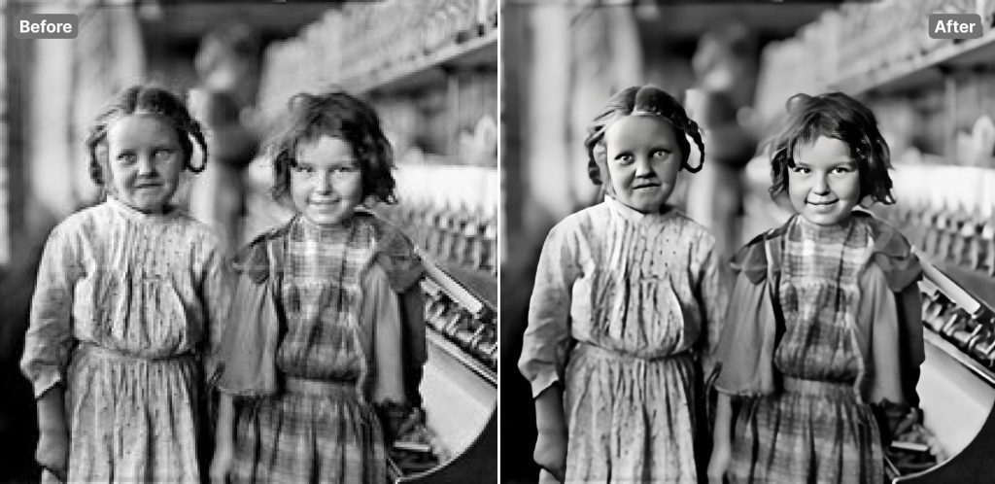
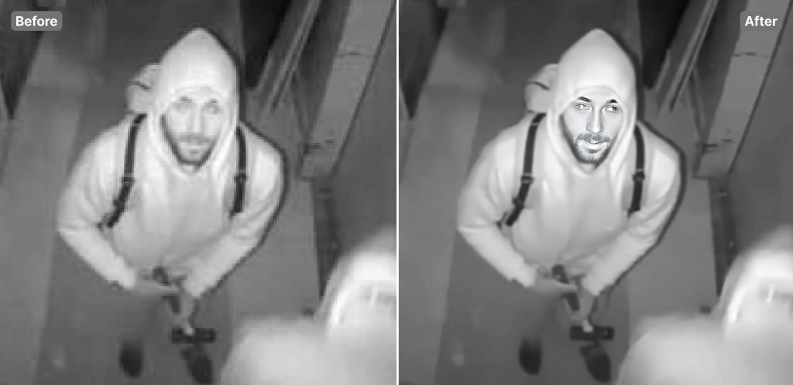
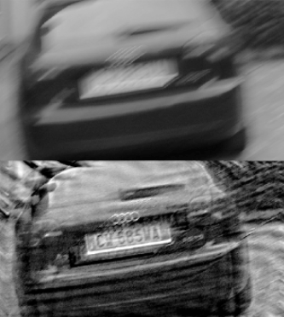
Problem Statement
To upscale old or compressed images.
Lack of customizations in online image upscaling tools.
Insufficiency of proper upscaling methods available for personal use.
As the available solutions rely on pre trained models, so the process may face security concerns.

Slide 4
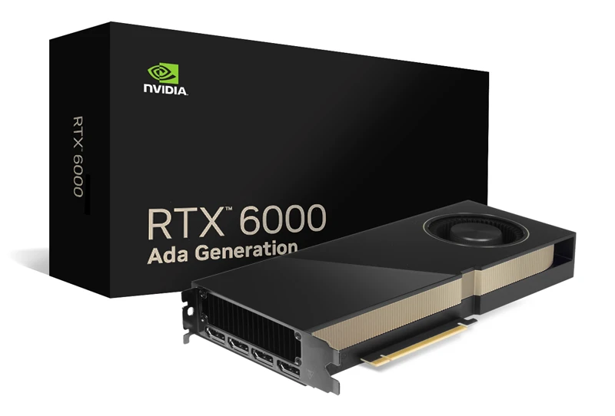
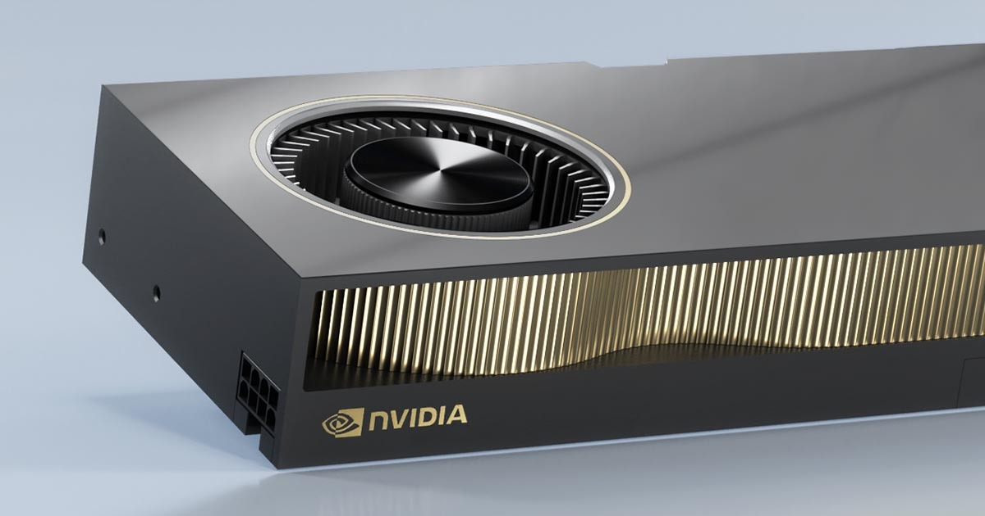
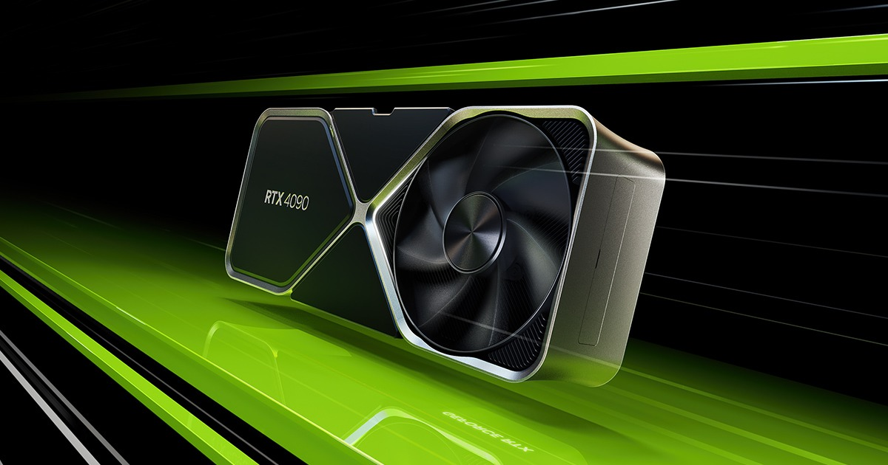
Problem Statement contd.
While GAN-based models traditionally require powerful, industry-level GPUs, advancements in optimization techniques and hardwares now allow for effective development on consumer-grade GPUs.
RTX 6000
(Industry grade)
RTX A6000
(Industry Grade)
RTX 4090
(Consumer grade)

Slide 5

Research Objectives
Detailed investigation of different existing GAN models.
Explore various combinations and possible changes in the architecture for optimal solutions in different scenarios.
Developing versatile and single category based datasets.
Constructing a GAN model which has unique specifications.
Consumer grade GPU friendly for both training and testing.
Compare the models with multiple evaluation metrics.

Slide 6


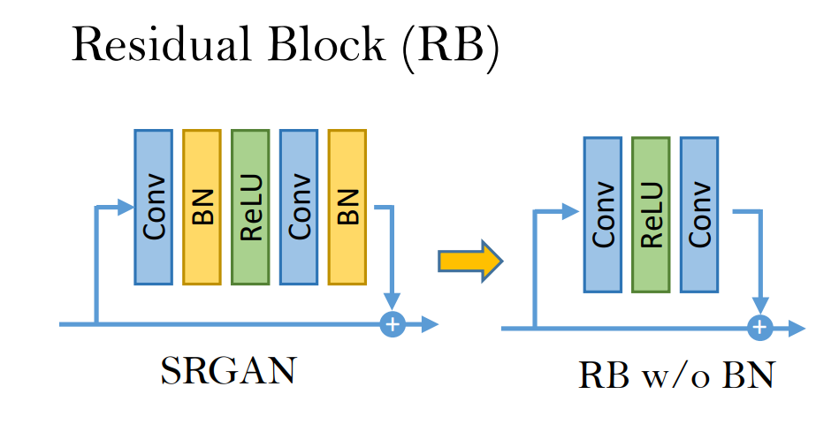
Existing Researches
SRGAN
Basic GAN model for Single Image Super Resolution.
Uses perceptual loss function.
Uses residual blocks with basic convolutional layers.
Uses batch normalization.
Photo-realistic single image super resolution using a generative adversarial network
Christian Ledig, Lucas Theis ET al.

Slide 7
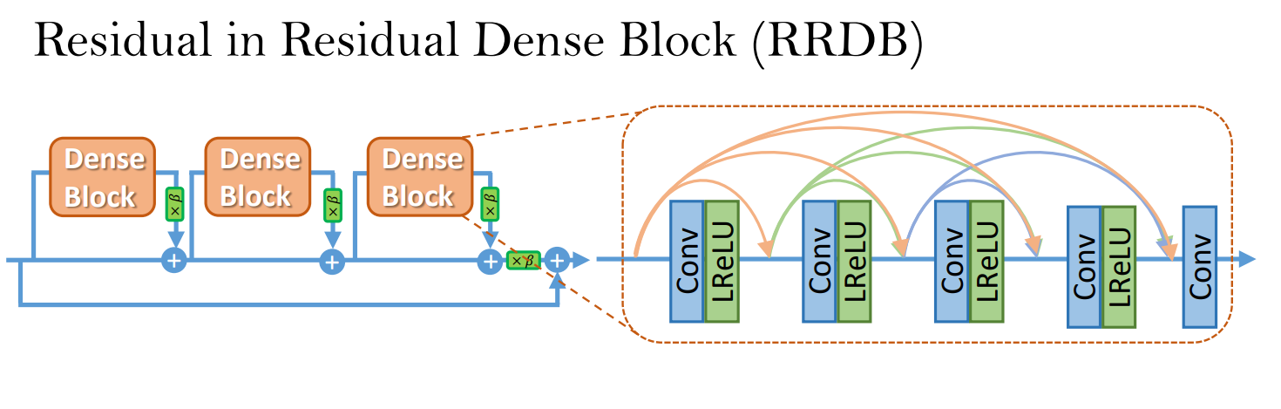
Existing Researches contd.
ESRGAN
Leaky ReLU is used as Activation function.
ESRGAN uses perceptual loss and adversarial loss.
Based on RRDB architecture.
Discards batch normalization.
Enhanced super-resolution generative adversarial networks
Xintao Wang, Ke Yu ET al.

Slide 8
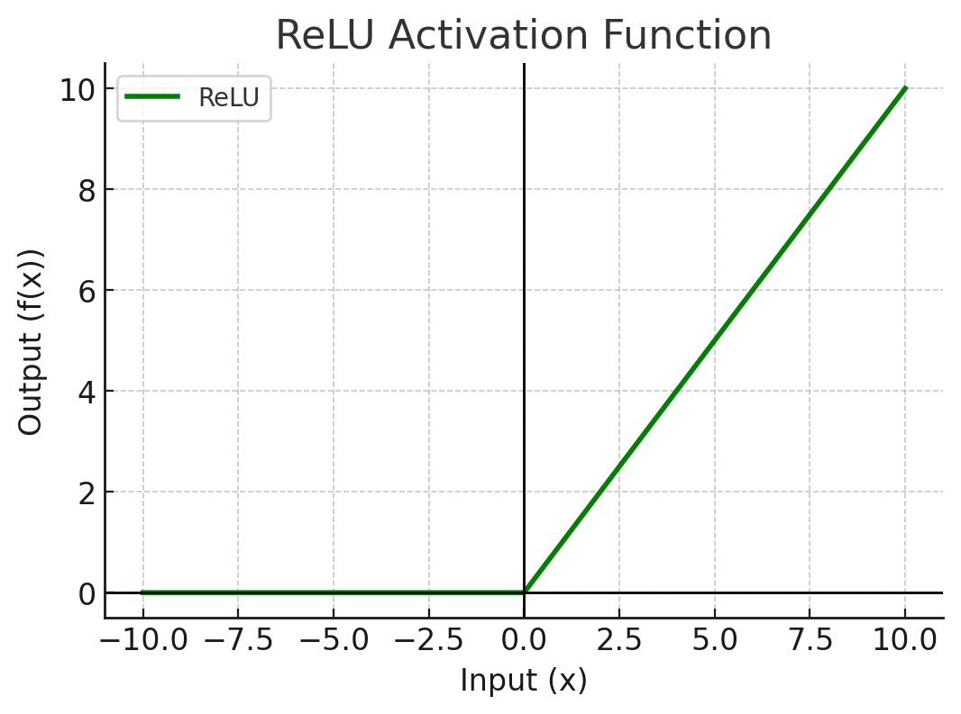
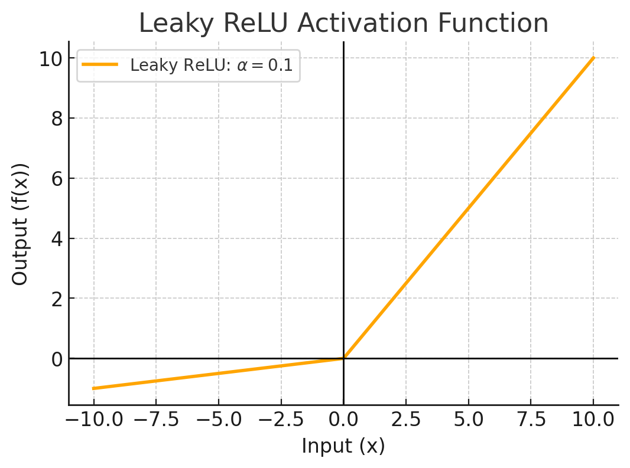
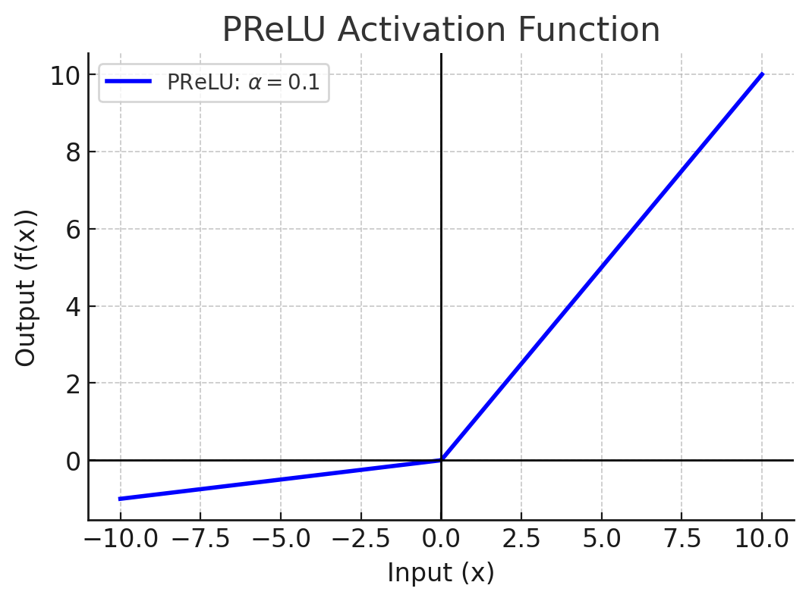
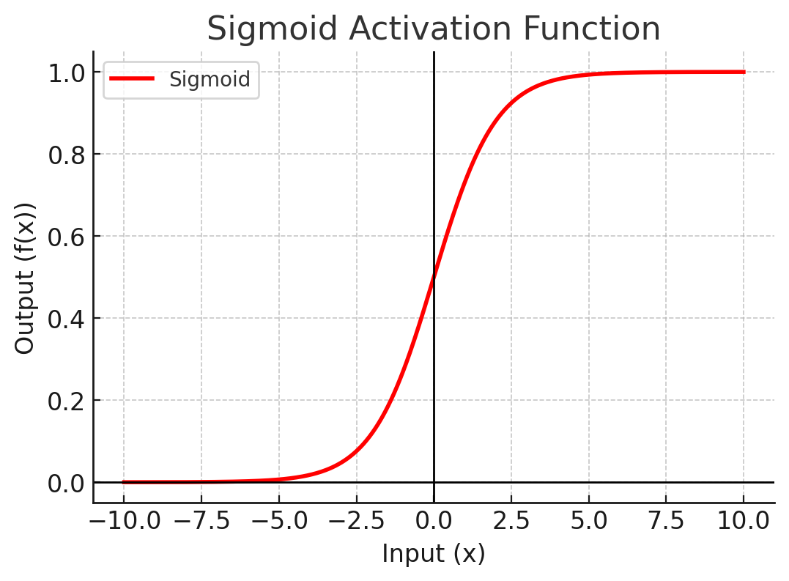
Activation Function
The Activation function decides if inputs move to the next layer.
ReLU Leaky ReLU PReLU Sigmoid

Slide 9

Combinations of Activation Functions
By combining different activation functions it is possible to get better results rather than using a single activation function.
Learning Combinations of Activation Functions
Franco Manessi, Alessandro Rozza

Slide 10

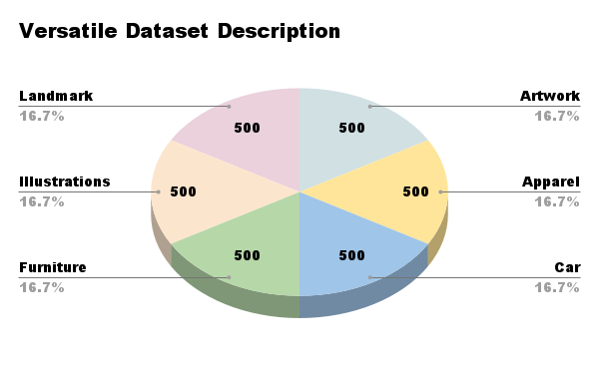
Dataset Description
The dataset we have selected is “130k Images (128x128) - Universal Image Embeddings” by Rohit Singh, one of the lead engineers at Samsung R&D.
Kaggle's usability rating of the dataset is 8.24.
The database consists of 11 categories with a total of 130k images.
To make a versatile dataset, we have selected 6 categories containing 3000 images.
Apart from the versatile dataset, we have made a single-category dataset with only furniture images. It has 2000 images.

Slide 11


Reason for a single category Dataset
Because all the GAN models that are established have worked on a single type of image. Like human faces, anime, illustration, etc. That is why we trained our model with just furniture category images as well.

Slide 12

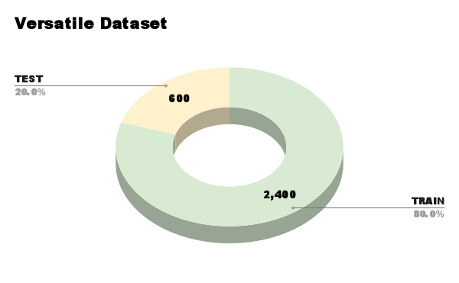
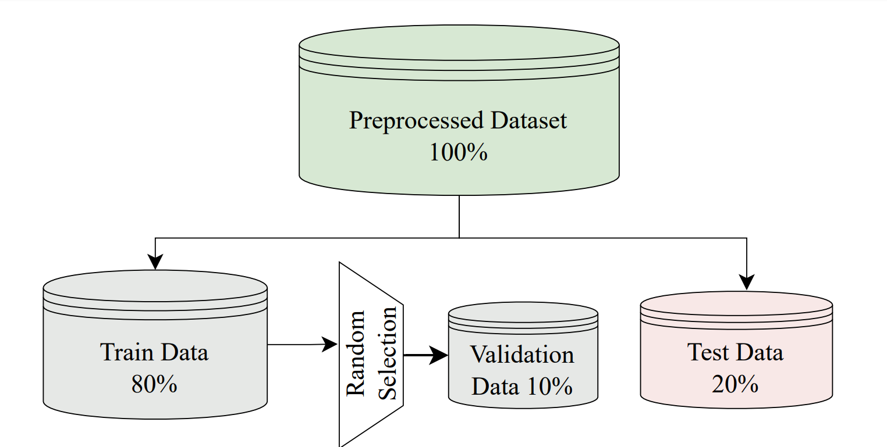
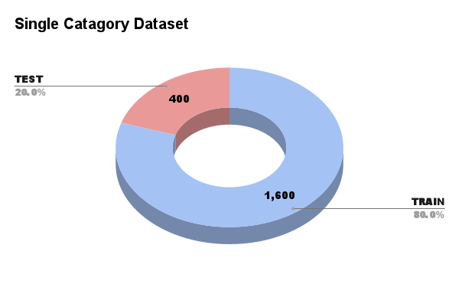
Dataset Splitting
We split both datasets into an 80:20 ratio, with 80% used for training and the remaining 20% set aside for testing.
The test data remained completely hidden from the model during training.
10% of the test dataset was randomly selected for validation. purposes.

Slide 13
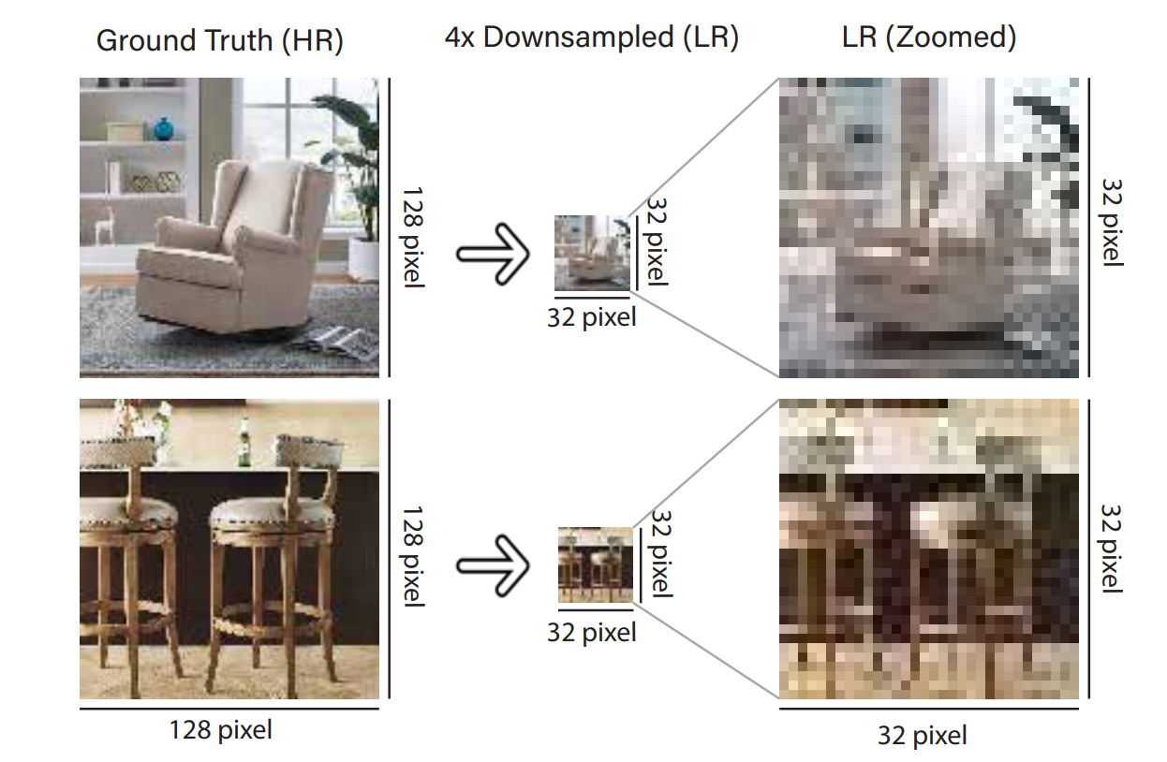
Dataset Pre-Processing
Down-scaling the Dataset
Paired datasets are used for training in deep learning models.
HR images serve as ground truth (GT); LR images are 4× downscaled versions.
LR images are stored separately, with filenames matching the HR images.
Image Denoising
In this research, we have chosen the “Gaussian Noise” method.
This allows to mimic real-world uncertainties like sensor noise and ambient conditions.

Slide 14

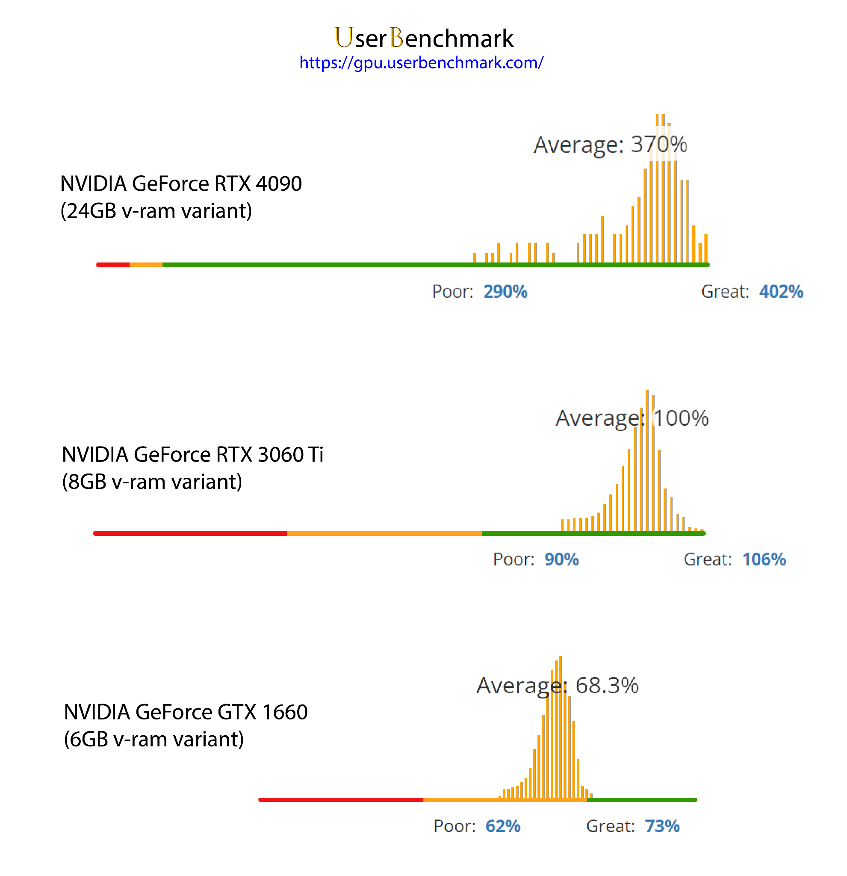
NVIDIA GeForce RTX 4090 (24GB VRAM)
Top-tier performance.
Used for initial model development to ensure smooth training and avoid bottlenecks.
NVIDIA GeForce RTX 3060 Ti (8GB VRAM)
Balanced performance and cost.
Achieved optimal trade-off between speed and resource usage.
NVIDIA GeForce GTX 1660 (6GB VRAM)
Tested for compatibility with lower-tier hardware.
Demonstrated successful, though slower, training and testing, model adaptability.
Hardware Configuration for Model Training

Slide 15



Development Environment:
Jupyter Notebook v7.0.8, Python v3.12.4.
Used for real-time code execution, cell-based flexibility, and GPU compatibility.
Key Libraries:
PyTorch: Model training and network building.
OpenCV: Image processing (downsampling, resizing).
Evaluation: PSNR, SSIM (skimage.metrics).
Visualization: matplotlib for training curves.
Software Environment

Slide 16

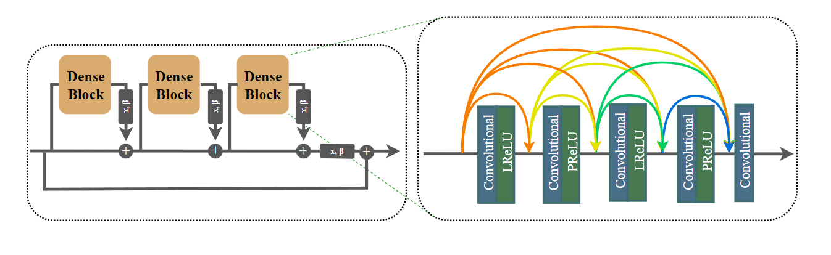
Proposed Model: MSRGAN
Generator:
Hierarchical feature extraction with RRDB model.
Each RDB layer with alternating Leaky ReLU and PReLU activations.
Discriminator:
Uses a combination of leaky ReLU, PReLU, and sigmoid activations.
Outputs a probability indicating the comparative authenticity of images.

Slide 17
LeakyReLU & PReLU Activation: Alternating activation functions for hierarchical feature extraction.
Residual-in-Residual Dense Blocks (RRDB): Improved capacity and residual learning at multiple levels.
Loss functions:
MAE (Mean Absolute Error) for content preservation. Optimized using RESNET-18.
Adversarial Loss for improving high-resolution realism uning binary cross-entropy with logits.
Total generator loss.
MSRGAN contd.

Slide 18
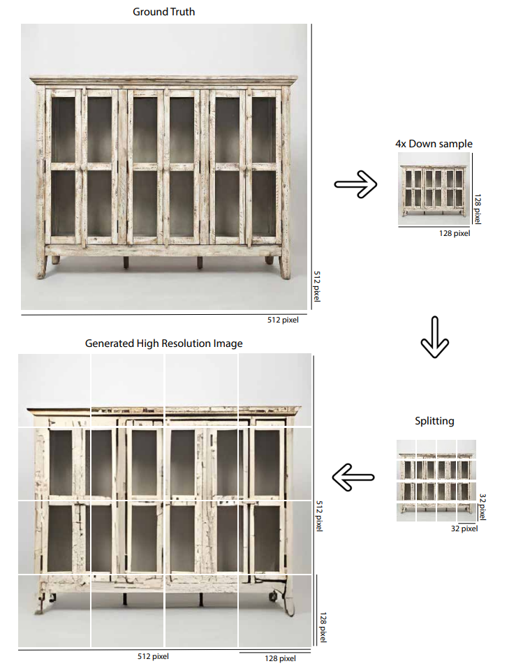
Upscaling Higher Resolution Images:
Splitting and Upscaling Method:
A 512x512 image is downsampled into 128x128.
Split into 16 patches (32x32 each), upscaled by 4x to 128x128, and then merged.

Slide 19

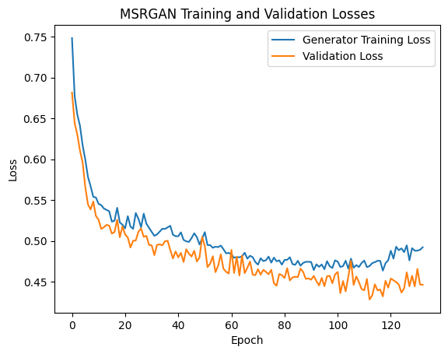
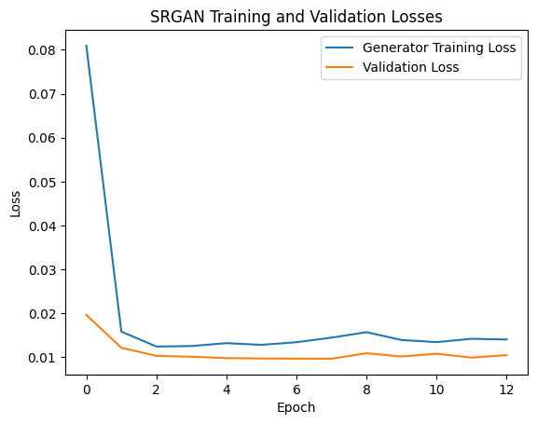
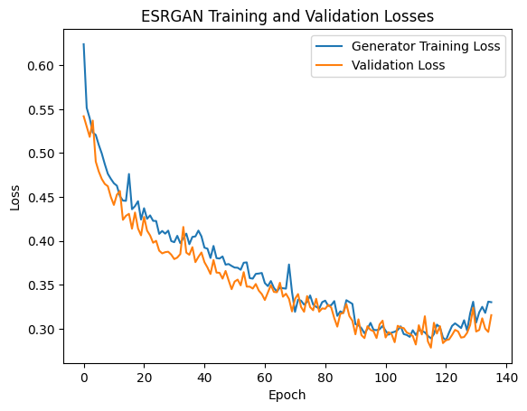
Inspecting Loss Curves
Balanced Learning
Free from Overfitting
Not Underfitting

Slide 20
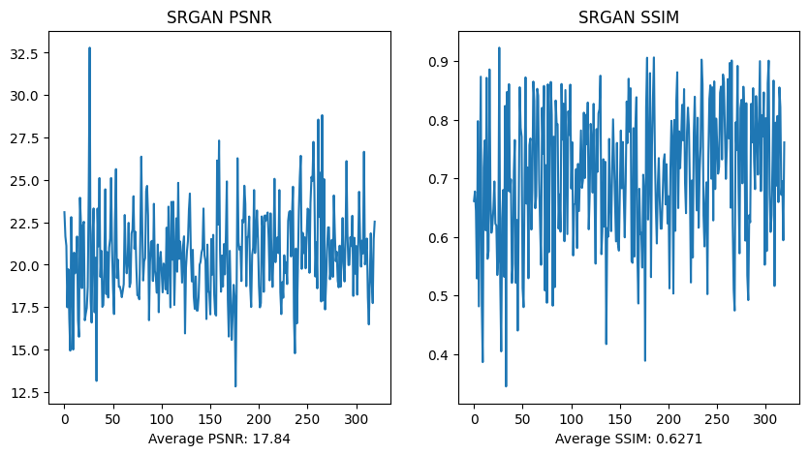
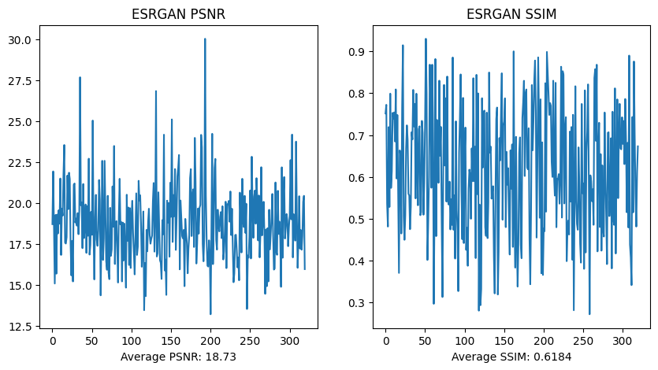
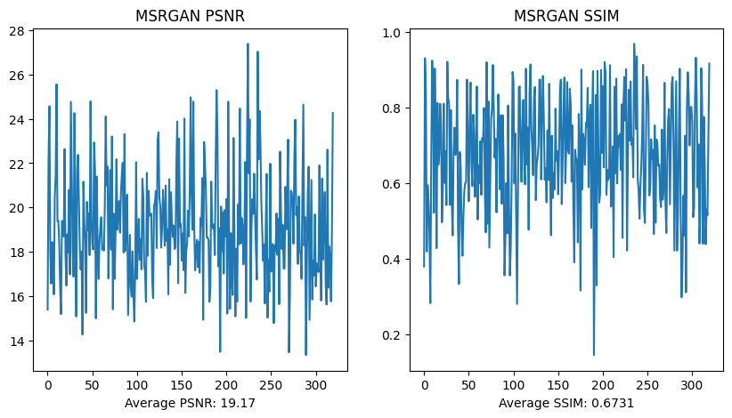
Evaluation Metric Result
PSNR (Peak Signal-to-Noise Ratio)
MSRGAN > ESRGAN > SRGAN
19.17 18.73 17.84
SSIM (Structural Similarity Index Measure)
MSRGAN > SRGAN > ESRGAN
0.6731 0.6271 0.6184

Slide 21

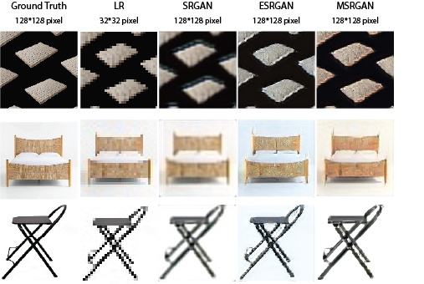
Visual Comparison
MSRGAN
Visually Better
Balanced Color
SRGAN
Blurry and Distorted
ESRGAN
Sharper and Noisy

Slide 22

Future Works
Incorporate attention mechanisms to focus on certain portions of the image to use the model on specific purpose.
Explore extending MSRGAN to multiscale super-resolution for more efficient and flexible upscaling.
Use knowledge distillation to transfer insights from a larger pre-trained model to MSRGAN, cutting training time and processing needs.

Slide 23

Conclusion
Custom GAN model named MSRGAN developed and evaluated.
Superior performance in image super-resolution compared to SRGAN and ESRGAN models.
Efficient on consumer-grade GPUs and personalizable for users, making it accessible to students and researchers.
A potential stepping stone for image super-resolution development.

Slide 24

Reference
C. Ledig, L. Theis, F. Huszar, et al., “Photo-realistic single image superresolution using a generative adversarial network,” in Proceedings of the IEEE Conference on Computer Vision and Pattern Recognition (CVPR), Jul. 2017.
X. Wang, K. Yu, S. Wu, et al., “Esrgan: Enhanced super-resolution generative adversarial networks,” in Proceedings of the European Conference on Computer Vision (ECCV) Workshops, Sep. 2018.
F. Manessi and A. Rozza, “Learning combinations of activation functions,” in 2018 24th International Conference on Pattern Recognition (ICPR), 2018, pp. 61–66. doi: 10.1109/ICPR.2018.8545362.

